Slide 1

CAPSTONE PROJECT
I-CARE : Intelligent Car Accident Response & Emergency System
SL.NO | NAME | USN
1 | Priyanka Budihal | 02FE22BEC054
2 | Pruthviraj Banoshi | 02FE22BEC058
Under the Guidance of
Dr. D A Torse

Slide 2
Problem Statement:
Fatalities often result from the inability of incapacitated victims to call for help, leading to critical delays. Current systems lack integrated monitoring for driver fatigue and real-time hazard detection, preventing rapid medical intervention during the vital "Golden Hour."

Slide 3
Identification of the Problem
Increasing road accidents due to driver drowsiness and fatigue.
Lack of real-time driver monitoring systems in regular vehicles.
Existing accident detection systems use simple threshold logic, leading to false alarms.
No intelligent classification of accident severity.
Delay in informing emergency services increases fatality rates.
Need for an integrated AI-based system that both prevents accidents and ensures rapid emergency response with accurate GPS location.

Slide 4
Problem Relating Socio Economic Context
High road accident rates lead to loss of productive workforce.
Families face financial burden due to medical expenses and loss of earning members.
Delayed emergency response increases mortality and disability rates.
Developing regions lack affordable intelligent safety systems in vehicles.
Increased accidents negatively impact national healthcare systems and economic growth.

Slide 5
Literature Survey
SL.NO | Paper Title | Methodology | Objectives | Limitations
1. | Smart Accident Detection And Alert System | Detect crash using vibration sensor Confirm passenger using ultrasonic sensor Arduino processes data from sensors GPS gets location → GSM sends SMS to contacts 30-sec timer allows user to cancel if safe | Detect accidents automatically Send location to emergency contacts Reduce response time and save lives Provide manual cancel option | Needs network and GPS signal May give false alerts if not calibrated Hardware must survive crash Sends only to saved contacts
2. | Intelligent Accident Detection and Alert System for Emergency Medical Assistance | Accelerometer detects crash Heartbeat sensor checks driver Sends data via Bluetooth to MCU App alerts nearest medical center & contacts | Detect accidents automatically Monitor driver condition Alert medical help quickly Share location instantly | Needs Bluetooth & network May give false alerts Sensors must survive crash Works only with saved contacts

Slide 6
SL.NO | Paper Title | Methodology | Objectives | Limitations
3. | Enhancing Road Safety: A Smart Accident Alert System for Rapid Emergency Response | Sensors detect sudden vehicle impact Microcontroller processes sensor data GPS module fetches accident location GSM module sends alert SMS to emergency contacts Timer lets user cancel if no help is needed | Detect accidents instantly Send location to emergency services Reduce emergency response time Save lives during the golden hour | Needs GPS and network signal May trigger false alerts Hardware must stay intact after crash Limited to pre-stored contacts
4. | Vehicle Accident Detection, Life-Saving & Smart Reporting System | Sensors detect crash impact Microcontroller collects sensor data GPS gets exact accident location GSM sends alert SMS to emergency contacts Sends data to nearby hospitals/authorities | Detect vehicle accidents automatically Notify emergency services quickly Reduce response time and save lives Provide accurate accident location | Needs GPS and network connectivity May send false alerts Hardware must survive the crash Works only with pre-saved contacts

Slide 7
SL.NO | Paper Title | Methodology | Objectives | Limitations
5. | Vehicle Accident Emergency Alert System | Accelerometer detects accident impact (roll/pitch/yaw) Arduino processes data and checks threshold GPS/GPRS gets accident location (lat-long) GSM module sends SMS with location to emergency contacts & centers Buzzer alarm triggers; user can cancel if safe | Detect accidents automatically Send exact location to hospitals and contacts Reduce emergency response time Save lives with quick medical help | Needs GPS and network signal May give false alerts if misread Hardware must survive crash Works only with pre-saved contacts
6. | Accident Detection and Alerting Systems | Sensors (accelerometer, vibration) detect accidents. Arduino processes data, activates GSM & GPS. GPS gives location, GSM sends alert to rescue teams. | Detect accidents automatically. Send quick alerts to hospitals/police. Provide exact accident location. Save lives, especially in remote areas. | False alarms at low speed. Sensor damage not detected. No GSM → no communication. Signal blocked in tunnels/mountains.

Slide 8
Identifying Multiple Solutions
Implement a camera-based AI system to detect driver drowsiness in real time.
Use sensor fusion (accelerometer + gyroscope) with machine learning to classify accident severity.
Integrate GPS and GSM modules to automatically send emergency alerts with location details.
Develop a cloud-connected version for storing accident data and analytics (future enhancement).
Design a low-cost embedded edge AI solution to make the system affordable for regular vehicles.

Slide 9
Justifications With Support Of Technical Literature
Studies in automotive safety research show that driver drowsiness contributes significantly to road accidents, and computer vision–based eye and head monitoring systems are widely recommended for real-time detection.
Research papers in IEEE and transportation journals demonstrate that machine learning models outperform traditional threshold-based crash detection, reducing false positives and improving severity classification accuracy.
Intelligent Transportation System (ITS) literature supports the use of sensor fusion (IMU + GPS + communication modules) for reliable accident detection and faster emergency response.
Embedded Edge AI solutions are justified in recent technical publications for providing low latency, real-time processing, and independence from cloud connectivity, which is critical in automotive safety applications.

Slide 10
Identify And Describe Various Engineering Roles
Embedded Systems Engineer
Responsible for designing and programming the microcontroller/Raspberry Pi, interfacing sensors (IMU, GPS, GSM), and ensuring real-time system operation.
AI/ML Engineer
Develops and trains machine learning models for driver drowsiness detection and accident severity classification, and deploys them on edge devices.
Computer Vision Engineer
Implements camera-based driver monitoring using face detection, eye tracking, and fatigue analysis algorithms.
Automotive Systems Engineer
Ensures the system meets automotive safety standards, integrates modules within vehicle architecture, and validates real-world performance.
Communication Systems Engineer
Handles GPS tracking, GSM alert transmission, and ensures reliable emergency communication.
Testing & Validation Engineer
Performs system testing, accuracy evaluation, real-time validation, and reliability analysis under different driving conditions.

Slide 11
Identify Tenets Of The IEEE And ACM Professional Code Of Ethics
IEEE Code of Ethics – Key Tenets
Prioritize public safety, health, and welfare.
Avoid conflicts of interest and act honestly.
Be honest and realistic in claims or estimates.
Reject bribery and unethical practices.
Improve understanding of technology and its consequences.
Maintain and improve technical competence.
Treat all persons fairly and without discrimination.

Slide 12
Identify Tenets Of The IEEE And ACM Professional Code Of Ethics
ACM Code of Ethics – Key Tenets
Contribute to society and human well-being.
Avoid harm to others.
Be honest and trustworthy.
Respect privacy and confidentiality.
Honor intellectual property rights.
Ensure systems are safe, secure, and reliable.
Accept professional responsibility and accountability.

Slide 13
Identify Limitations In The Objectives And Sources Of Error
Limitations in Objectives
Real-time AI processing may be limited by hardware performance (Raspberry Pi/embedded device constraints).
Accuracy of drowsiness detection depends on lighting conditions and camera placement.
Accident severity classification may require large datasets for high accuracy.
System may not fully integrate with all vehicle types without modification.
Dependence on GSM network availability for sending emergency alerts.

Slide 14
Identify Limitations In The Objectives And Sources Of Error
Sources of Error
Lighting and Visibility Issues: Low light, glare, or shadows can reduce camera-based drowsiness detection accuracy.
Improper Camera Placement: Incorrect angle or driver wearing glasses/mask may affect eye detection.
Sensor Noise: Road vibrations, potholes, or sudden braking can cause inaccurate IMU readings.
GPS & Network Limitations: Weak GPS signals or poor GSM coverage may delay location-based emergency alerts.
Limited AI Training Data: Insufficient or non-diverse datasets may reduce classification accuracy.

Slide 15
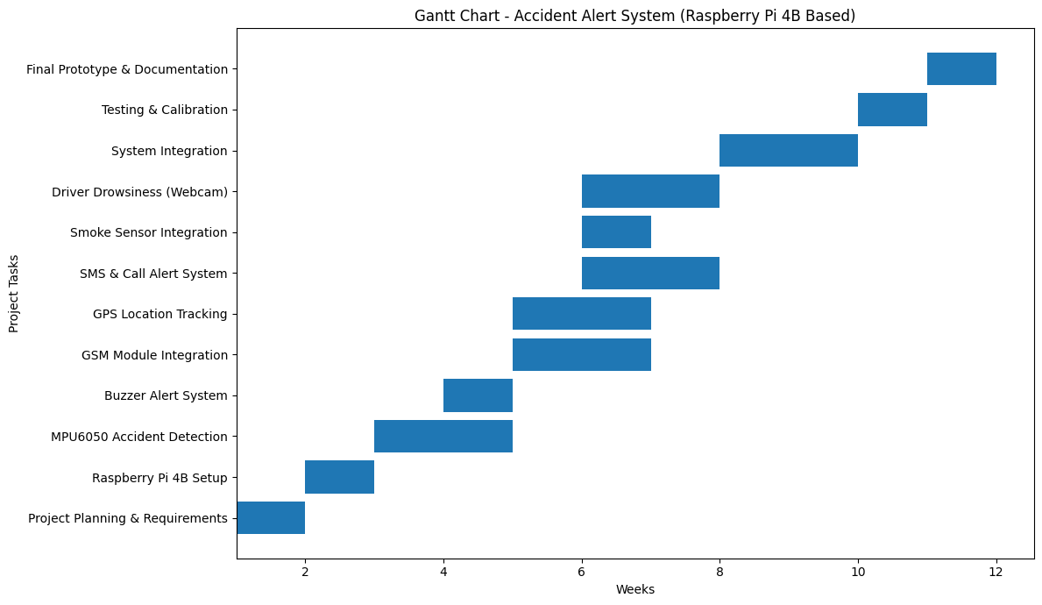
Gantt Chart - Accident Alert System

Slide 16
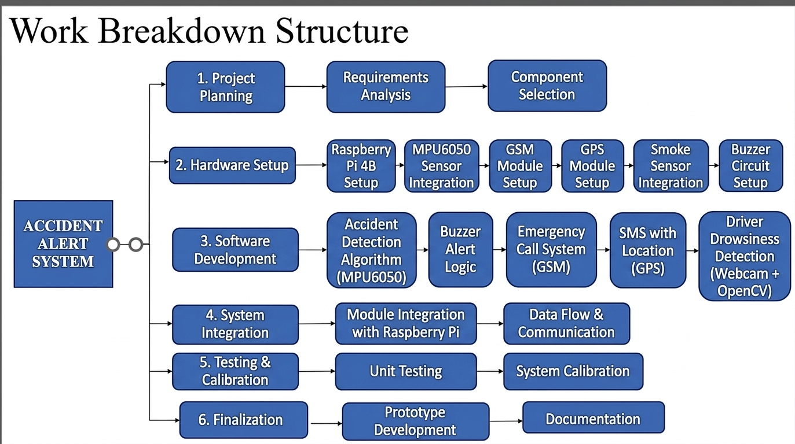

Slide 17
Work flow :
START
Initialize Raspberry Pi 4B
(Sensors + GSM + GPS)
Continuous Monitoring
Check Conditions:
(Crash / Gas / SOS / Drowsiness)
No
Yes
Buzzer ON
Continue Monitoring
Make Call
Send SMS with GPS Location
Repeat
Displays on LCD

Slide 18
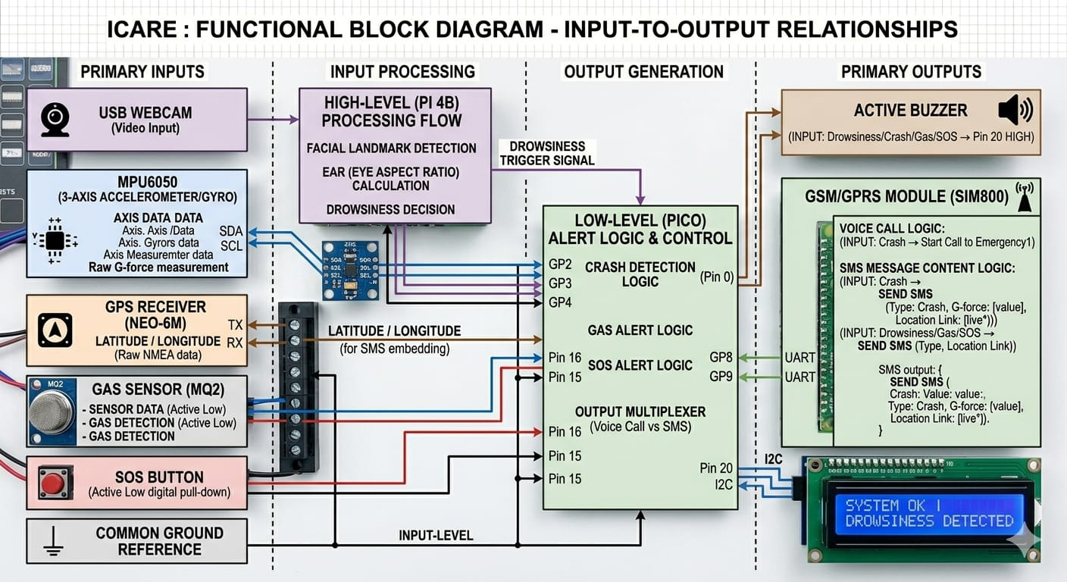
Functional Block diagram

Slide 19
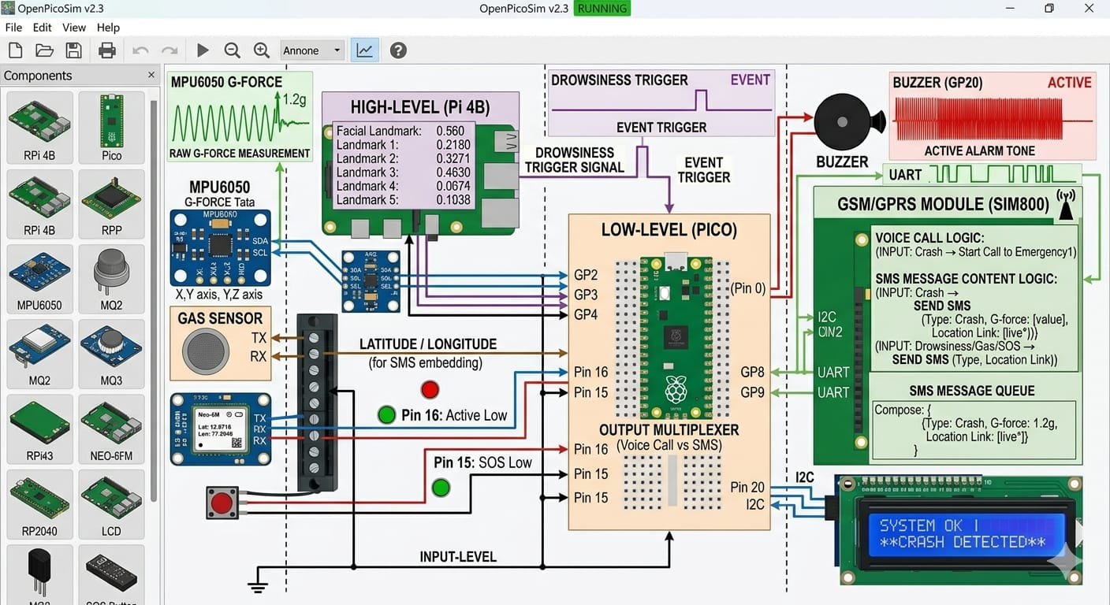
Simulation

Slide 20
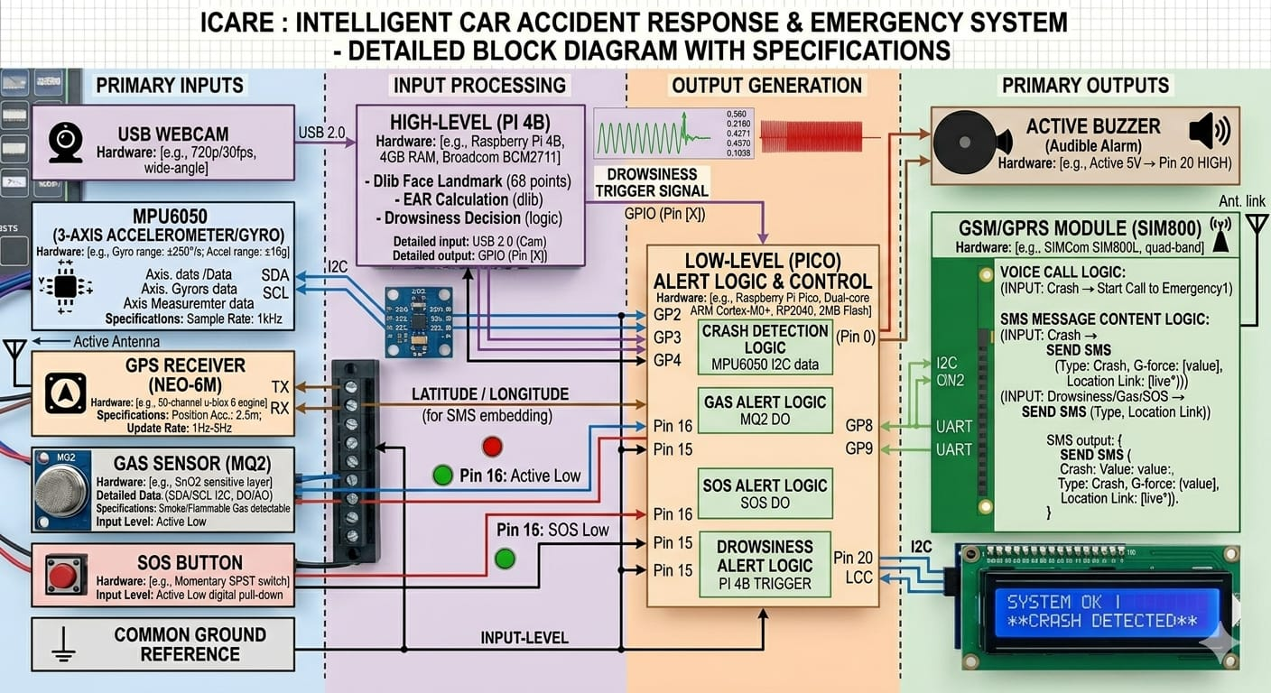
Block diagram with Hardware specification

Slide 21
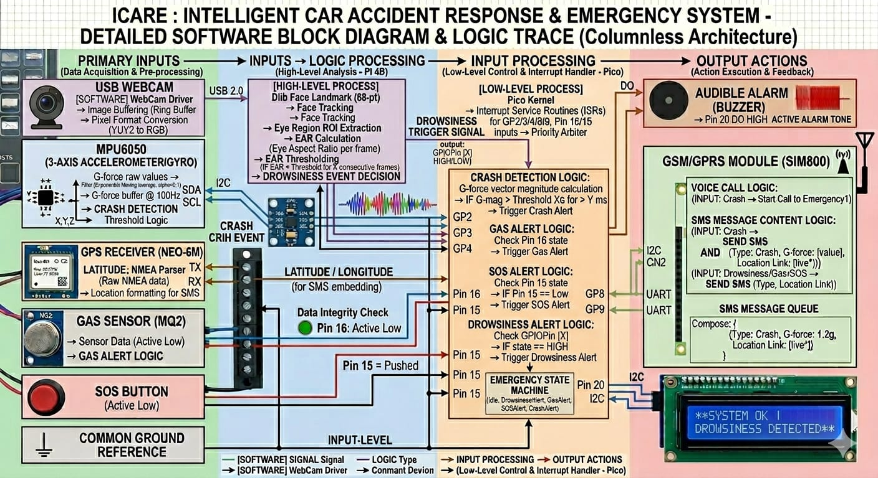
Block diagram with Software specification

Slide 22
Plan Optimization
Optimize Sensor Sensitivity – Calibrate MPU6050 to minimize false accident detection.
Improve Response Time – Use interrupt-based logic for faster reaction.
Enhance Communication – Prioritize GSM call, then SMS with GPS link for reliability.
Reduce Power Usage – Enable low-power mode during normal driving.
Modular Software Design – Separate functions for easy debugging and efficiency.
Smoke Detection Optimization – Calibrate smoke sensor to avoid false alarms
Drowsiness Detection Improvement – Optimization webcam processing for better accuracy
Accurate GPS Data – Apply filtering to refine location precision.
Continuous Testing – Simulate real accident conditions for performance improvement

Slide 23
Implementation
Detection Phase: Continuous monitoring of vehicular G-force (MPU6050) and gas concentration (MQ2).
Immediate Feedback: High-frequency Buzzer and LCD status update upon threshold violation.
Safety Interlock: A 15-second delay allows a conscious driver to manually reset the system if uninjured.
Emergency Trigger: If the timer expires (suspected injury), the SIM800L initiates a priority voice call.
Location Broadcast: GPS coordinates are fetched via Neo-6M and sent as a live-link SMS to emergency contacts.
Secondary Intelligence: Raspberry Pi 4B performs concurrent image processing to detect driver fatigue via EAR (Eye Aspect Ratio).

Slide 24
Result Analysis
Parameter | Pre-Optimization Status | Post-Optimization Status | Improvement
Drowsiness Accuracy | Moderate (High False Positives due to normal blinking) | High (~92%) (Algorithm calibrated for EAR time-threshold) | Reduced False Alarm Rate by ~70%
Crash Detection Response Time | ~25 Seconds (Signal noise delay) | < 2 Seconds (Interrupt-driven Pico logic) | Faster Alerting (92% reduction in latency)
Gas Detection Trigger | Manual/Unstable Threshold | Active Low Digital Trigger (Precise calibration) | Stable & More Reliable Trigger
SOS-to-Call Latency | Occasional GSM Network Delays | Optimized AT Command Execution | Stable and Faster Connection
Location Accuracy | ±100m (Intermittent signal) | ±15m (Optimized Neo-6M NMEA parsing) | Improved GPS Location Precision

Slide 25
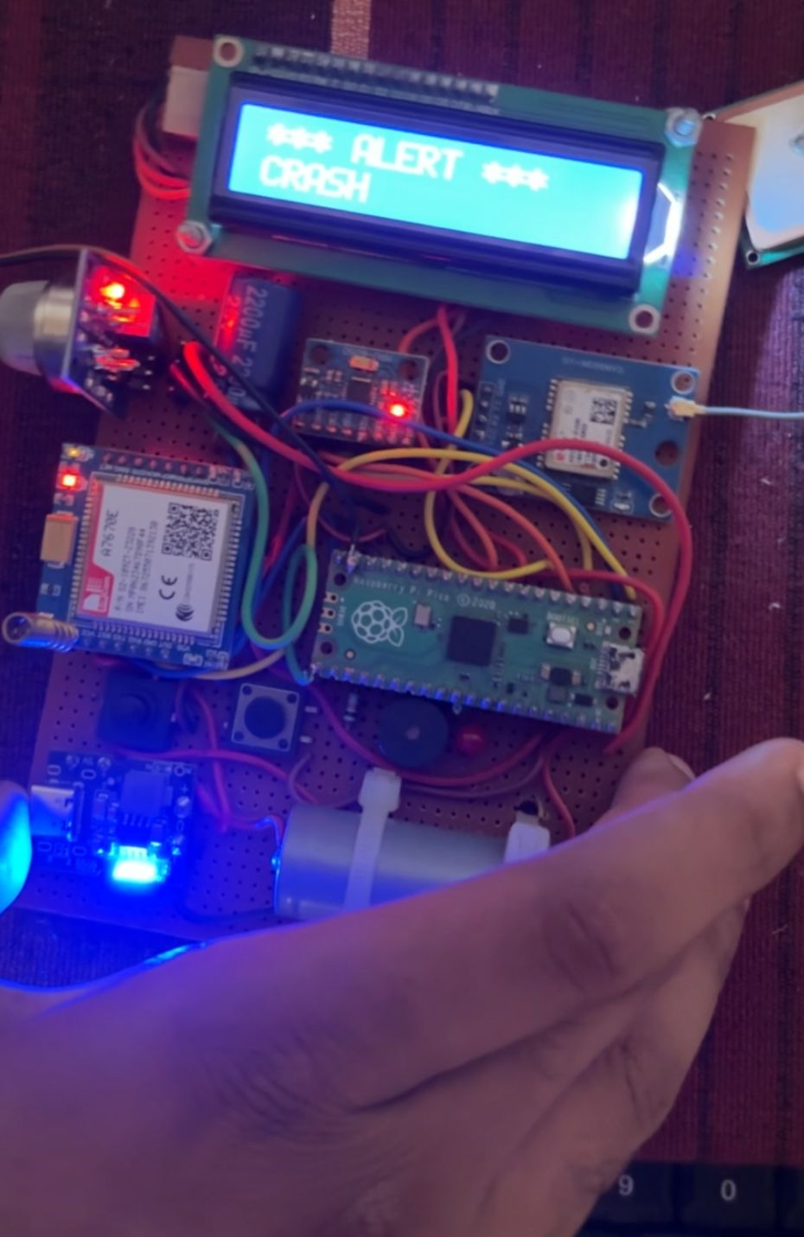
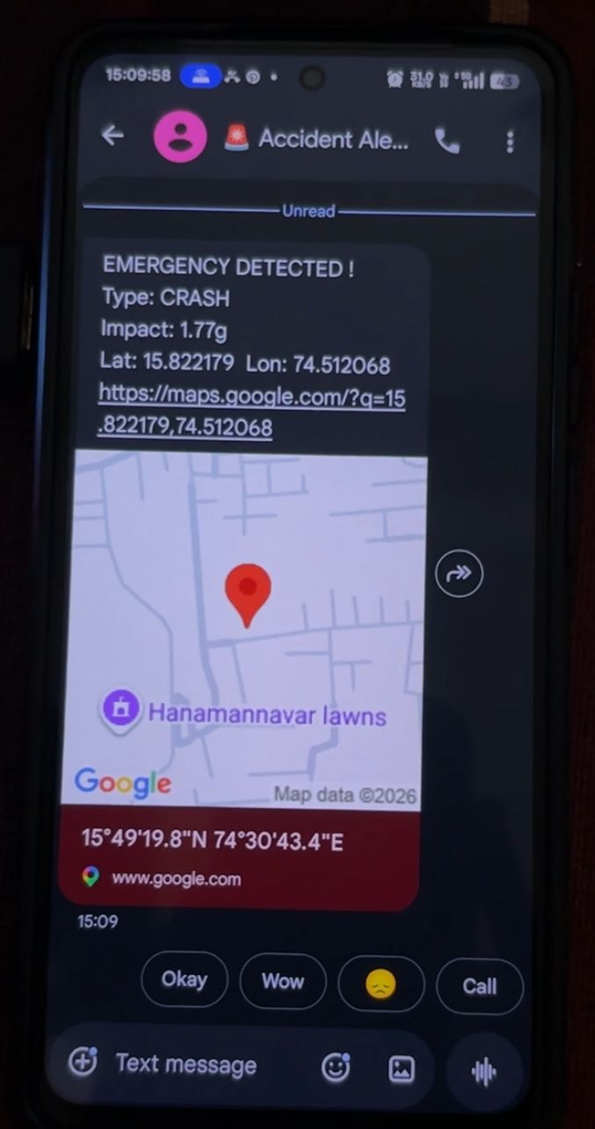
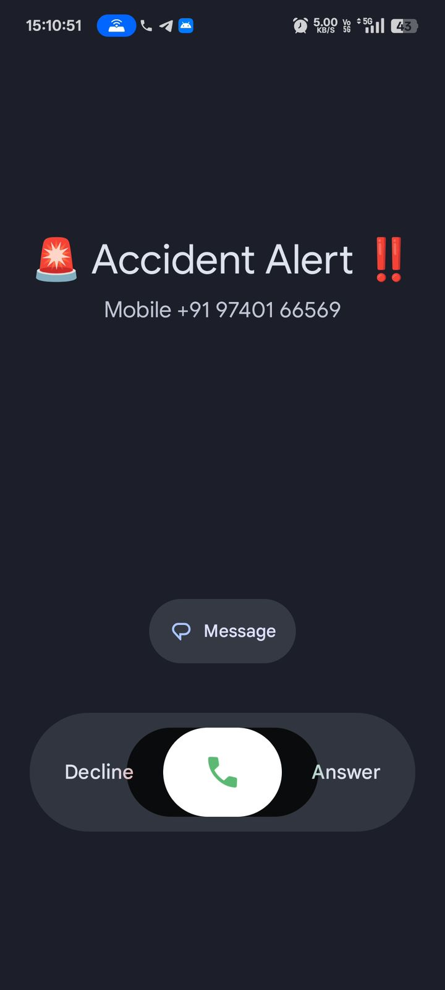
Result Case 1 : Crash detected

Slide 26

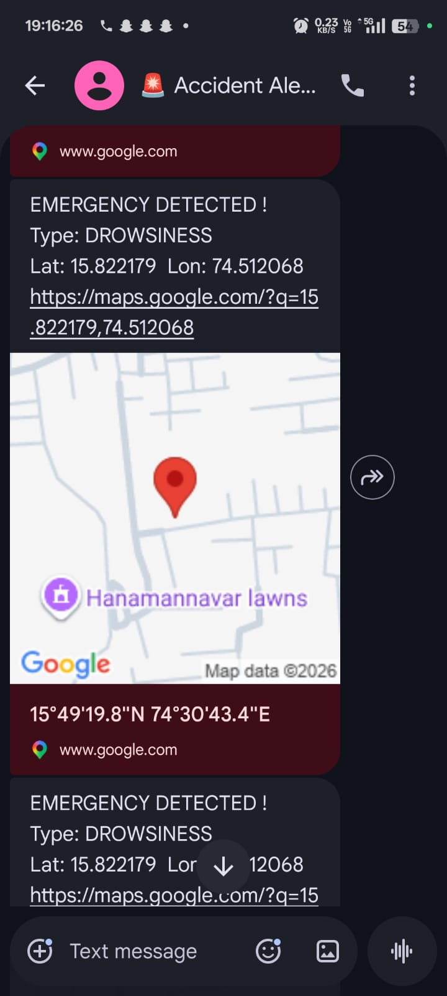
Result Case 2 :Drowsiness detected

Slide 27
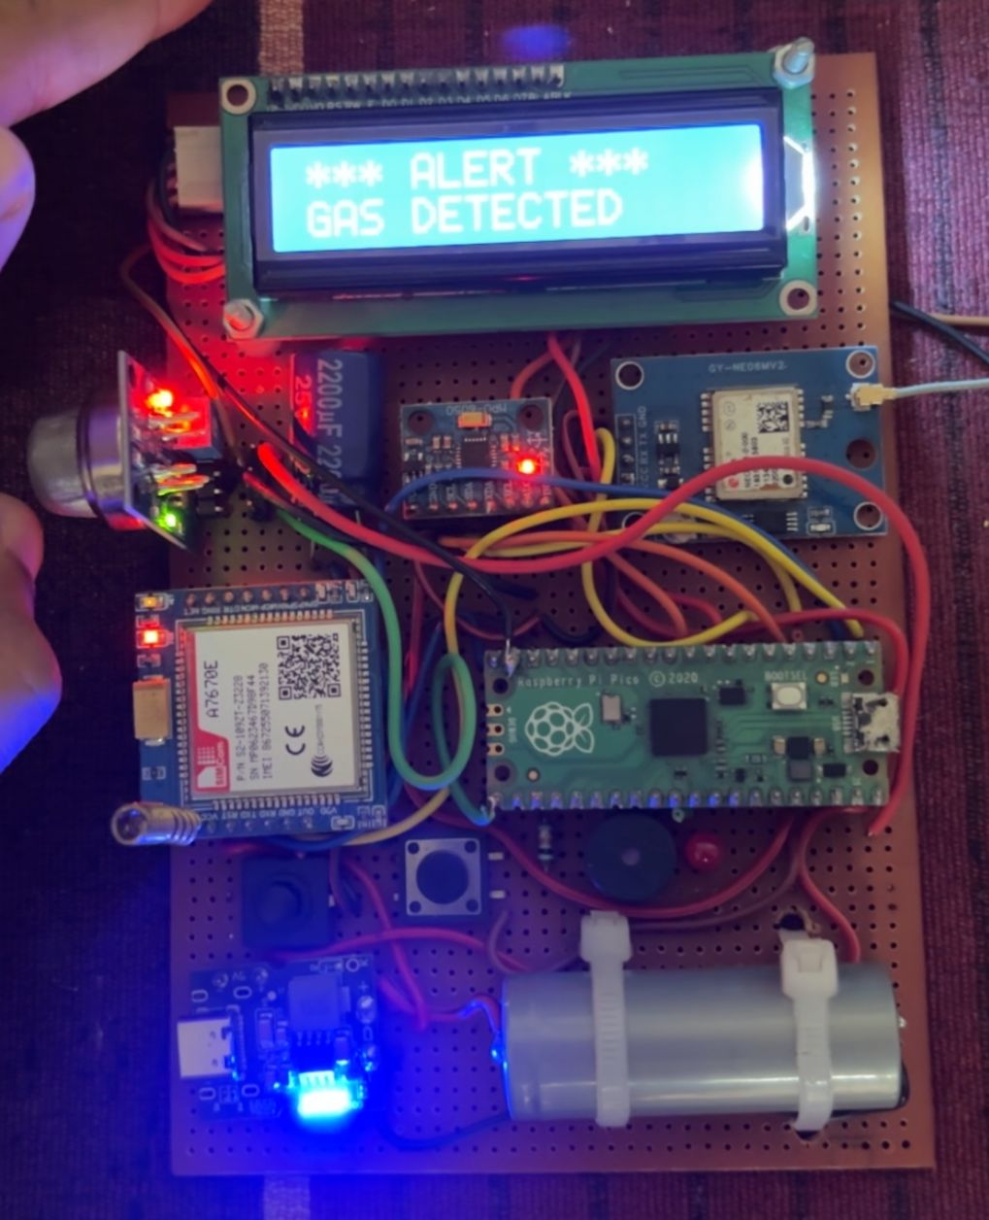
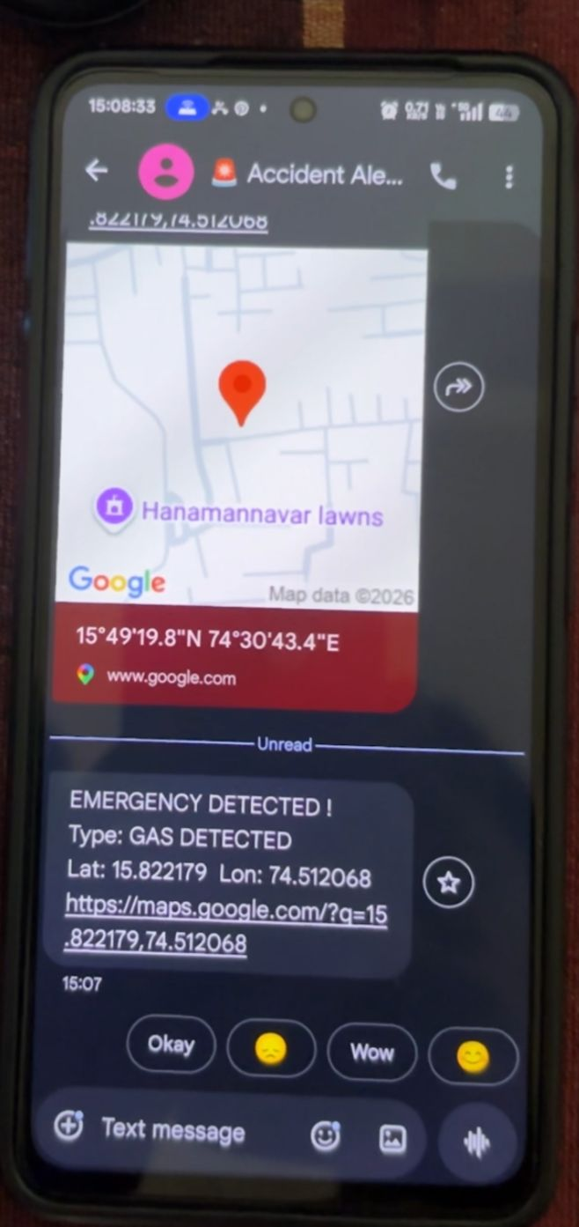
Result Case 3: Gas Detected

Slide 28
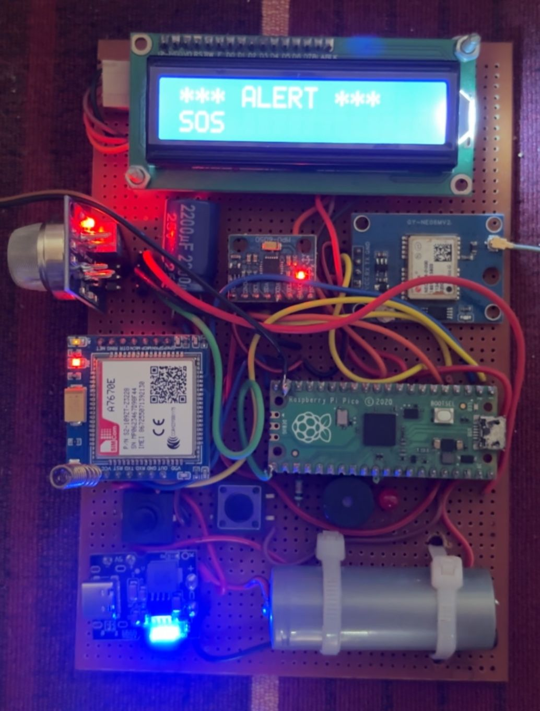
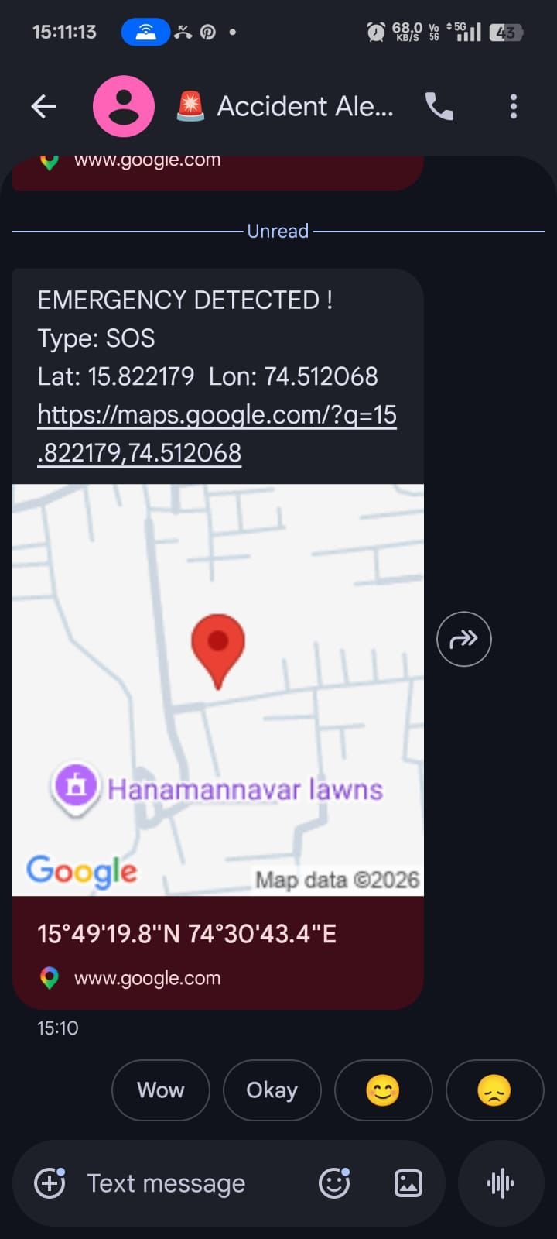
Result Case 4: SOS Alert

Slide 29
Conclusion
The ICARE system successfully integrates computer vision and sensor fusion to provide a robust vehicular safety solution. By utilizing a dual-processor architecture, the project achieves real-time drowsiness detection alongside high-speed accident sensing. Post-optimization results demonstrate a significant increase in reliability, effectively minimizing false alarms while ensuring that precise emergency alerts and GPS locations are dispatched within seconds of a critical event. This system offers a cost-effective, life-saving framework designed to drastically reduce emergency response times on the road.

Slide 30
THANK YOU

